Slide 1
Class 10 Slides: Utopia Discussion

Slide 2
Lots of Good Qs this Week
Let’s Focus on Questions on Meaning/Purpose:
Matt B: According to the authors (1) our ultimate role in a 'solved/euphoric' universe is merely to be interesting passengers, does the pursuit of knowledge still serve as a tool for evolution, or does it become (2) a form of 'epistemic cheating' where we intentionally forget what the AI already knows just to feel the satisfaction of a 'new' discovery?
Lewis: Is death necessary for meaning? (Paraphrase)
Carlo: If you know before entering that the simulation is artificial, can the struggles and achievements inside it still feel genuinely meaningful?
Manny: Is human effort rendered meaningless when the output can be perfectly optimized by a machine?
Colton: does the lack of "bad" in the world actually make it a dystopia?
Alex: Is "life feels meaningless when everything is perfect" a human problem, or just an intellectual's problem?

Slide 3
What should a Utopia Have?
Bostrom Identifies a Few Things:
Utility (e.g. Pleasure & Absence of Pain)
Interestingness
Purpose
Meaning

Slide 4
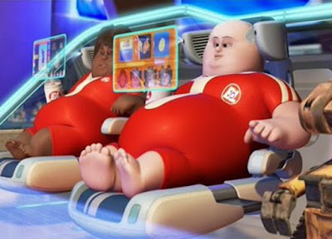
Would we become pleasure blobs?
Hedonic Valence (i.e. pleasure)
But would we become “mere pleasure blobs”?

Slide 5
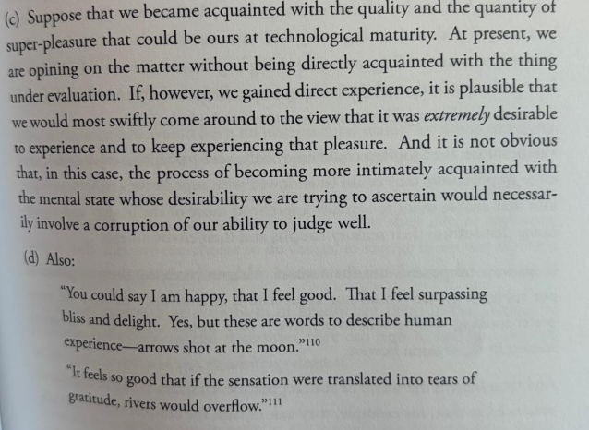
Would we become pleasure blobs?
Do we underestimate the pleasure blobs?

Slide 6
Would losing purpose be so bad?
Hedonic Valence (i.e. pleasure)
Experience texture
Autotelic activity
‘Artificial purpose’
Sociocultural entanglement

Slide 7
Deep Utopia on Meaning
What’s the meaning of life?

Slide 8
Deep Utopia on Meaning
What’s the meaning of life?
42

Slide 9
Do these lives have meaning?
A Chapman student who works hard to get an MSBA, and goes on to live a long, mostly happy life embedded in the communities of their choosing (e.g. a faith, or civic organization), with a family, 1.9 kids, and a suburban home
A radical anarchist who rejects society, and joins a terrorist group seeking to destroy the government, and dies in a suicide bombing at age 25

Slide 10
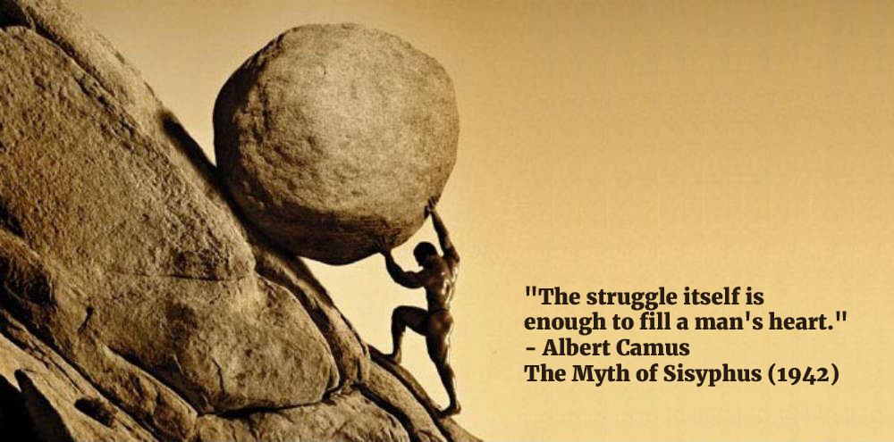
Does This Life Have Meaning?

Slide 11
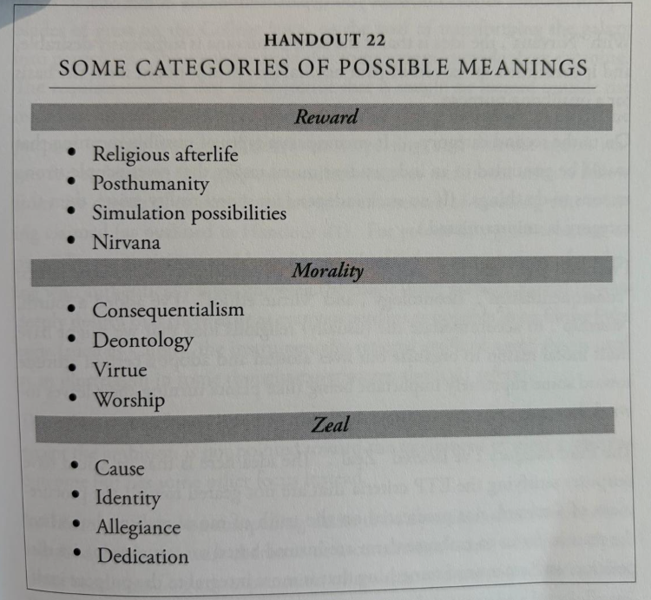
A Taxonomy of Meanings
Which of these would be more or less achievable in a post-AGI utopia?

Slide 12
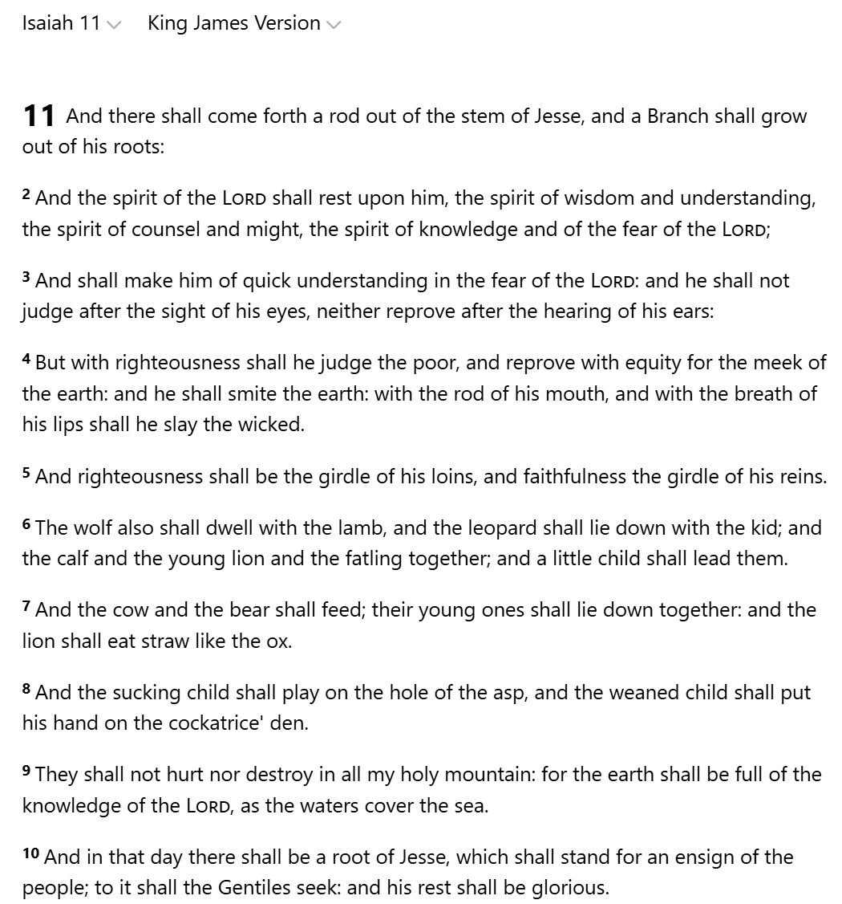
A Theological Perspective
Dostoyevsky doubts fallen humanity is capable of utopia (it will rebel)
What’s the Providential special sauce that would make the Messianic Age/Heaven actually desirable?

Slide 13
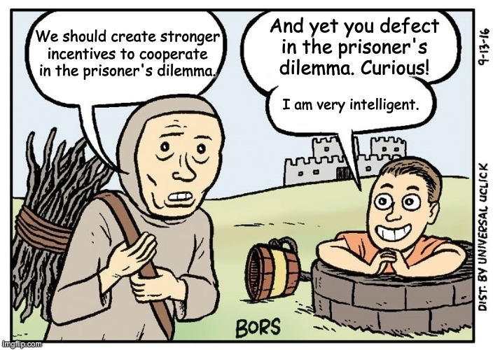
Other Topics
Alexxis: How to get AIs to convergently evolve to cooperate with humans + each other rather than dominate?

Slide 14
Other Topics
Francis: If robots drive the marginal cost of production to near-zero, how does the economy solve for Positional Scarcity (non-replicable goods like land or history)?
How do our readings approach these?

Slide 15
Additional Final Project Guidance
The final project will ask students to imagine how AI and digital technologies could or should be used in the future. Possible forms include, but are not limited to:
A novel statistical analysis, based on public or collected data, meant to answer an empirical question about the effect of technology on some outcome
A computer program demo-ing some digital platform feature they hope to emerge
A film visualizing the user experience for a proposed or speculative AI or digital technology, and investigating it’s consequences
A business plan and investment pitch for a profitable and socially beneficial enterprise using these technologies

Slide 16
Additional Final Project Guidance
We encourage you to work on something that can be part of your work portfolio, and/or expands on something already in your portfolio

Slide 17
Additional Final Project Guidance
Presentation and discussion timings:
25 minutes for a group of one + 10 mins discussion
30 minutes for a group of two + 15 mins discussion
35 minutes for a group of three + 15 mins discussion

Slide 18
Additional Final Project Guidance
Every project must include a final artifact in addition to the presentation, for example:
A statistical analysis or computer science/AI alignment research project should include:
An academic style research note explaining methods, sources, etc, as well as a github page with data + code for replication
A computer program project that the professor and students can demo
Comits by every member of the team and readme explaining files
Every project should have a breakdown of how members + AI contributed
Before leaving class today, confirm your final artifacts!

